Slide 1
Online Money Map with Wordpress
Course Name: HND in Computing Batch Number: SE-07

Slide 2
Content
Introduction
Significance of the topic
Team Members
Budget
Timeframe (Gantt Chart)

Slide 3
Introduction
Our topic - Wordpress
Proposed Topics?
Networking
Cloud computing
Web development
Wordpress
DB Management
Linux Kernel

Slide 4
Significant of the topic
Why selecting this topic?
Expected outcome

Slide 5
Team members
Lasith Manuranga
Lahiru Mahakumburage
Umesha Sandeepa
Binidu Pavith
Pabasara Amarakoon
Yasas Amaraweera
Ranesh Yadithya
Sadev Induwara
Chamath Gaurawa
Dithmi Prameesha
Demashi Apeksha
Sandeeka Mandini
Tharushi Ruwanka
Tashmila Ransilu
Supuni Abeywickrama
Imanshi Nethmini

Slide 6
Key roles
Member | Role in the Project
Dithmi, Tharushi, Sadev, Yasas | Coordinator
Umesha, Lahiru, Yadithya, Chamath | Shaper
Lasith, Binidu, Umesha, Lahiru | Specialist
Supuni, Binidu, Yadithya, Yasas | Implementer
Pabasara, Lasith, Yadithya | Plant
Apeksha, Sandeeka, Imanshi | Resource Investigator
Supuni, Tashmila, Pabasara | Completer
Lasith | Monitor evaluator

Slide 7

Tharushi Ruwanka
- Coordinator
Acting as a chairperson.
Clarifying goals
Promoting decision-making
Delegrating effectively

Slide 8
Dithmi Prameesha
- Coordinator
Acting as a chairperson.
Clarifying goals
Promoting decision-making
Delegrating effectively

Slide 9
Sadev Induwara
- Coordinator
Acting as a chairperson.
Clarifying goals
Promoting decision-making
Delegrating effectively

Slide 10
Yasas Amaraweera
- Implementor
Turning ideas into practical actions.
Organizing work efficiently.

Slide 11
Demashi Apeksha
- Resource Investigator
Exploring opportunities.
Developing new contacts.

Slide 12
Sandeeka Mandini
- Resource Investigator
Exploring opportunities.
Developing new contacts.

Slide 13
Imanshi Nethmini
- Resource Investigator
Exploring opportunities.
Developing new contacts.

Slide 14
Pabasara Amarakoon
- Completer / plant
Generating new ideas.
Solve difficult problems.
Timely completion of tasks.
Maintaining standerds.

Slide 15
Lasith Manuranga
- Plant/Specialist
Generating new ideas.
Solving Difficult Problems.
Bringing in-depth knowledge and expertise

Slide 16
Ranesh Yadithya
- Implementor/Shaper
Turning ideas into practical action.
Driving the team to forward.

Slide 17
Binidu Pavith
- Implementor/Specialist
Turning ideas into practical actions.
Organizing work efficiently.
Generating new ideas.
Solving Difficult Problems.

Slide 18
Chamath Gaurawa
- Shaper
Driving the team to forward
Challenging the team to improve

Slide 19
Supuni Abeywickrama
Implementor/Completer
Turning ideas into practical actions
and plans .
-Organizing work efficiently
-Ensuring thorough
-Timely completion of tasks

Slide 20
Umesha Sandeepa
- Shaper/Specialist
Challenging the team to improve.
Driving to team forward.
Bringing in-depth knowledge and expertise.

Slide 21
Tashmila Ransilu
- Completer
Acting as a chairperson.
Clarifying goals
Promoting decision-making
Delegating effectively

Slide 22
Lahiru Mahakumburage
- Shaper/Specialist
Acting as a chairperson.
Clarifying goals
Promoting decision-making
Delegating effectively

Slide 23
Team meetings
Formal meetings ?
Every Wednesday 8.30 AM to 9.30 AM
Informal meetings?
Every Sunday 9.00 PM onwards via Discord

Slide 24
Team communication
Google Meet
Whatsapp Group chat
Discord

Slide 25
Date/Time | Sub Topic | Conducted | Back-up
9.30-10.00 | Introdution of Wordpress | Lasith | Lahiru,Binidu
10.00-10.30 | Domain and Hosting | Lasith | Lahiru,Binidu
10.30-11.00 | Introduce Tools of Wordpress | Lahiru | Lasith,Binidu
11.00-11.15 | Themes and Plugins | Lasith | Binidu
11.15-11.30 | Short Break
11.30-12.00 | Plan your website | Lahiru | Lasith
12.00-1.00 | Build Your Website | Lasith | Lahiru,Binidu
1.00-1.30 | Mobile Optimization | Lahiru | Binidu
1.30-2.30 | Earn money from Wordpress | Lasith | Lahiru
2.30 | Lunch and Ending

Slide 26
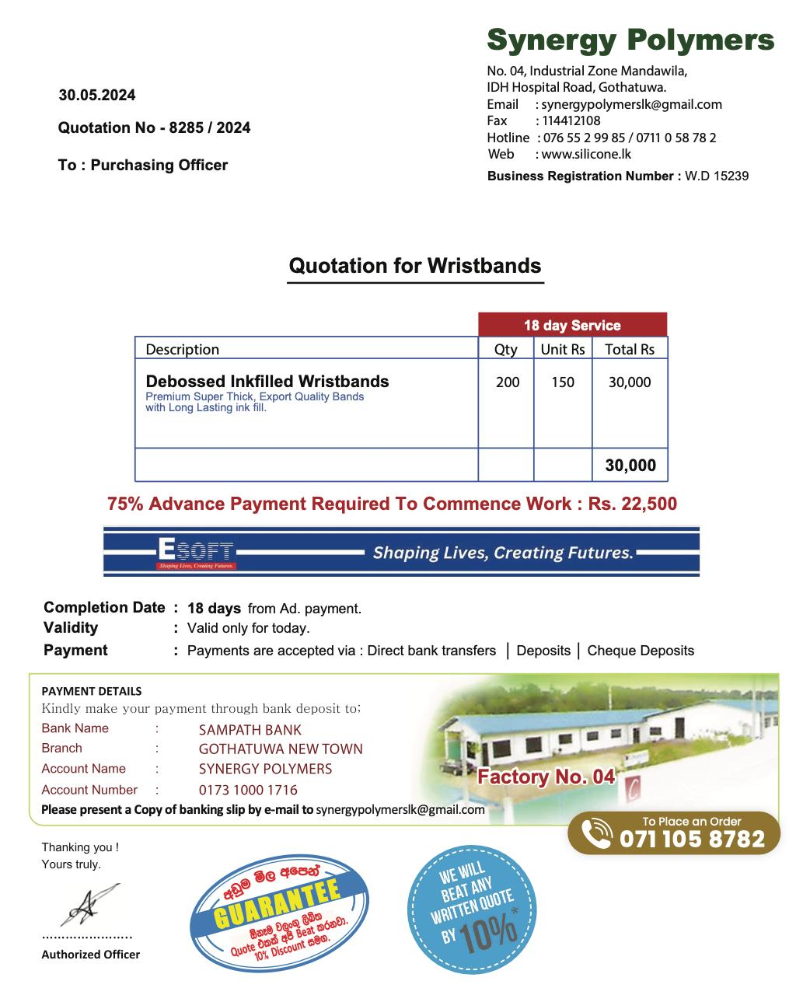
Budget
We are going to sell wristbands as our primary fundraiser.
We intent to raise Rs.28000.00 by selling wristbands
Our quotation shows as follow

Slide 27
Budget
Item | Amount
Fund raiser | 28000
Expenses | 25750
Expected income?
28000
Summary of expenses
Item | Amount
Foods and beverages | 9750
Gifts | 7500
Travelling | 2000
Stationary | 4500
Others | 2000
Total | 25750

Slide 28
Time frame (Gantt Chart )
Key Activity | Week 1 |  |  |  | Week 2 |  |  |  | Week 3 |  |  |  | Week 4
Finalizing the Topic
Assigning Team roles

Slide 29
Q & A

